Slide 1
Retention of tgnc
undergraduate stem students
EDU 6222: Contemporary Issues Capstone
March 9, 2023
Maia Almeida
Diane Saraceni
Shannon Usher

Slide 2
Positionality statement
We are cisgender White women working on a project for transgender and gender nonconforming students. We are allies – and this was the lens through which we approached our research. We do not share the lived experience of this community, but hope that we can use our position to make Northeastern University a more equitable space for these students.

Slide 3
tgnc
undergraduate stem student retention
why stem students?
Retention rates for transgender and gender non-conforming (TGNC) undergraduate students in STEM are approximately 10% lower than that of their cisgender peer students (Maloy et al., 2022)​
background
TGNC undergraduate STEM students experience extensive discrimination, harassment, and mental health challenges (Maloy et al., 2022)
theory
proposal
LGBTQA people are 17–21% less represented in STEM fields than expected
considerations
looking forward

Slide 4
tgnc
undergraduate stem student retention
TGNC history
2004 Sanlo offered a suggested approach to study the lives, experiences, and perseverance through graduation of lesbian, gay, and bisexual college students
background
Intersectionality play a large role in the innovation of LGBTQA student involvement
theory
proposal
At least 1.4 million persons self-identify as TGNC = A greater proportion of college students are identifying as TGNC = a greater number of STEM TGNC Students (Maloy et al., 2022)
considerations
looking forward

Slide 5
tgnc
undergraduate stem student retention
about northeastern
Private, not-for profit Institution (IPEDS, 2021)
Three undergraduate campuses: Boston, Oakland, London
background
R1 Level Research Institution (Carnegie R1 and R2 research classifications doctoral ... - CEHD, n.d.)​
theory
LGBTQA Resource Center located in the Curry Student Center (Northeastern University, n.d.)​
proposal
The Resource Center is where most affinity groups hold meetings – oSTEM​
considerations
No data collection for LGBTQA-identifying student retention (IPEDS) ​
looking forward

Slide 6
Theoretical framework
Validation Theory ​
(Rendón, 1994; Rendón & Muñoz, 2011)​
Marginality and Mattering Theory ​
(Schlossberg, 1989)​
Academic and personal development
Attention​
Increased self-worth​
Importance​
Prerequisite for student development
Ego Extension​
In and out of classrooms​
Dependence​​
Continuing process​
Appreciation​
Early intervention​
Notes:
​
Two key theories emerge as the basis of our work: validation theory and the marginality and mattering theory. Centered on the idea that validation is not something a student creates for themselves but rather when someone takes an active role in assisting them, validation theory contains six elements: (1) validation enables, confirms, and supports academic and interpersonal development, (2) validation allows students to feel capable of learning because of increased self-worth, (3) validation is a prerequisite for student development, (4) validation can occur in and out of classroom spaces, (5) validation is not an end goal, it is a continuing process of development, and (6) validation is most effective when introduced to a student’s experience early–specifically in the first weeks of the first year of college (Rendón, 1994; Rendón & Muñoz, 2011).​
​
Where validation gives students self-confidence to succeed, mattering gives students a feeling of belonging and being relied on, important, and dependable. Marginality and mattering exist at two ends of a sliding scale. Marginality can be temporary. Every time someone engages in change, in roles or other life transitions, they face the potential of feeling marginalized. It can also be permanent, as often seen in cases of cultural differences or even in systems of oppression. Ultimately, everyone experiences being marginal at times–perhaps most universally as a first-year student on a college campus (Schlossberg, 1989). ​
​
To combat the experience of marginality, we engage in a process of mattering. Mattering has five notable aspects, (1) attention: feeling noticed, (2) importance: the belief that one’s wants and needs are cared about and considered by others, (3) ego extension: feeling like others take pride in one’s success and share in one’s failures, (4) dependence: feeling that a person can depend on someone else, and (5) appreciation: feeling that one’s efforts are appreciated by others (Schlossberg, 1989). ​
​
The intersection of validation theory and marginality and mattering theory creates a view of student involvement from two angles: external validation that becomes internal motivation, and external acceptance and encouragement that creates an internal feeling of belonging. Validation and mattering are key in student involvement for nontraditional students (Rendón, 1994; Rendón & Muñoz, 2011; Schlossberg, 1989). Since integration and involvement in academic and social spaces are keys to student retention (Tinto, 1993), institutions therefore must take action to create spaces that engage in validation of students and to create a feeling of mattering in students.

Slide 7
tgnc
undergraduate stem student retention
Resource guide
Created as a one-stop shopping document to house information for easy access​
background
Informational links are related to NU and Boston area
theory
Guide is easily accessible on various NU webpages and can be customized for different campuses
proposal
Designated employee will be responsible for making updates as needed​
considerations
QR code created; can add to webpages, stickers, posters, printouts, etc.
looking forward
Notes:
The goal of the Resource Guide is to have as many TGNC STEM related resources available in one convenient location. The resource guide assists in the validation and mattering of TGNC STEM students by showing a variety of engagement opportunities, both on campus and locally, that can enable them to thrive and feel like they belong and matter to the community. Although this resource packet was created specifically for TGNC STEM undergraduate students, many of the documents can be leveraged by all LGBTQA students, faculty, and staff. It was thoughtfully created with the understanding that many of our campuses can customize the guide to their specific location. ​
​

Slide 8
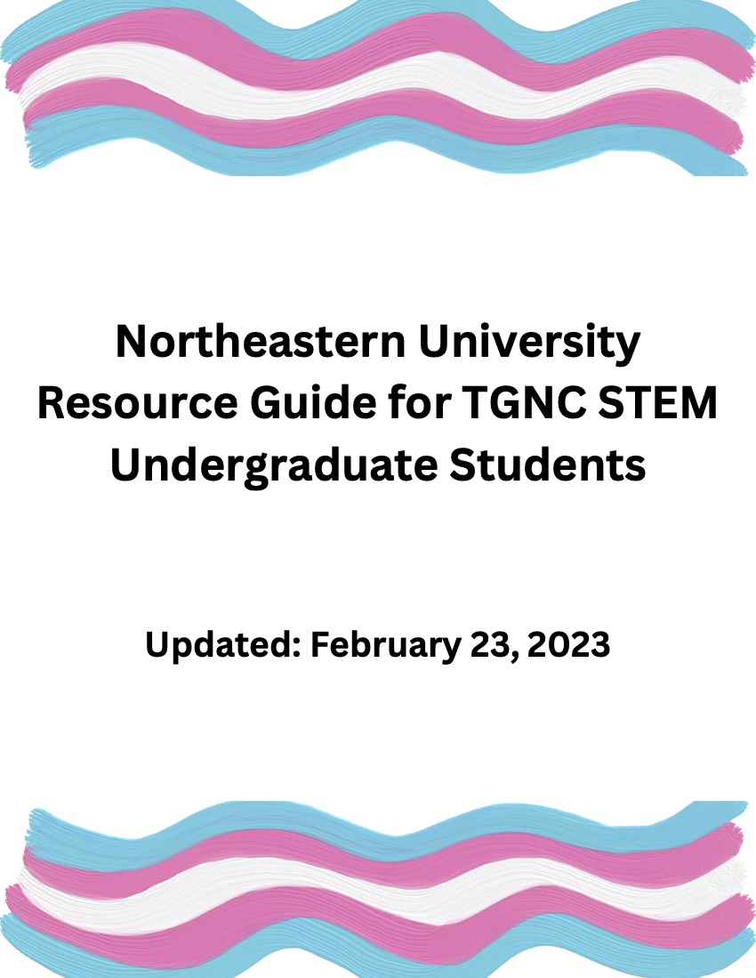
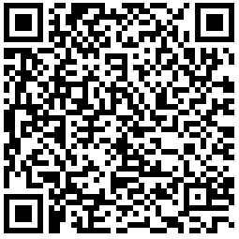
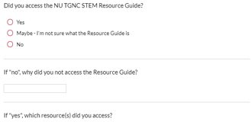
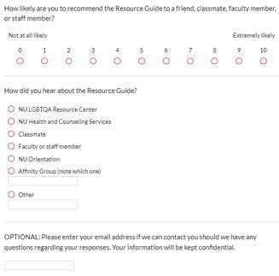
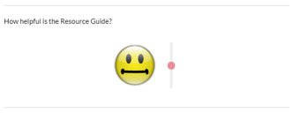

tgnc
undergraduate stem student retention
Resource guide
Created as a one-stop shopping document to house information for easy access​
background
Informational links are related to NU and Boston area
theory
Guide is easily accessible on various NU webpages and can be customized for different campuses
proposal
Designated employee will be responsible for making updates as needed​
considerations
QR code created; can add to webpages, stickers, posters, printouts, etc.
looking forward
Notes:
At the end of the academic year, an assessment survey will be sent to the email distribution list that the NU LGBTQA Resource Center manages, asking participants to complete​
the survey regarding the resource guide. The assessment survey should be sent to the entire distribution list, whether they accessed the resource guide or not. The data collected from these surveys will be used to assess and adjust the resource guide as needed. The first question will ask if they accessed the resource guide, and if not, why. This will provide data to understand any changes that need to be made to the resource guide so more users will leverage it. If they did access the resource guide, there is a series of questions to gather and analyze data to make improvements and understand the needs of the users. Additional data on the success of this resource can be gathered from the web host of the site the guide is posted on. Many web platforms can track how often a particular site is shared, a link is accessed, or a file is downloaded. This metric will show how useful this resource may or may not be. Similar data can be collected from the QR generator; a paid membership to QR.io allows members to create unlimited QR codes and analyze scan statistics. $35/month or $350/year​
​

Slide 9
tgnc
undergraduate stem student retention
Mentor program
Aligns with current NU academic Plan, Experience Unleashed​
background
Support student mentees
Support faculty, staff, and graduate student mentors by conducting mentor training​
theory
Applications for mentors and mentees will be completed through a NU Qualtrics survey​
proposal
considerations
looking forward
Notes:
The first goal of the mentor program is to align with NU’s academic plan, Experience Unleashed, specifically with these pillars and areas noted in the plan that reference diversity and inclusiveness: “a profound sense of belonging across all our campuses”, “a diverse and inclusive community of students, faculty, and staff, with our many global partners and in the neighborhoods that surround our campuses”, “Build on the power of diversity”, “Develop an academic community that reflects the diversity of our surrounding society and completely embraces and leverages that diversity in all its forms for an equitable and inclusive university”, and “Our diversity is reflected in our different social identities, including race, gender, sexual orientation”.​
​
The second goal is to support the student mentees by helping them build skills and have meaningful conversations, and to allow for professional development opportunities for faculty and staff mentors – all in a safe and supportive space. Furthermore, by engaging in establishing relationships across students, faculty, and staff in and out of the classroom, this program is rooted in validating students and fostering a sense of community, belonging, and mattering.​
​
Mentors will participate in training that includes roles and responsibilities, and general mentor meetings. ​

Slide 10
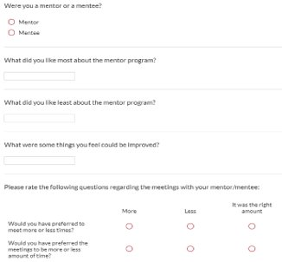
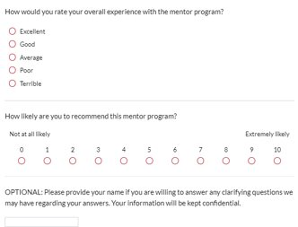
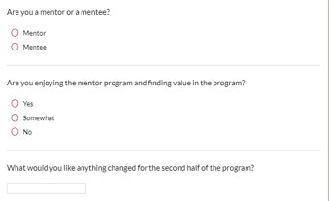
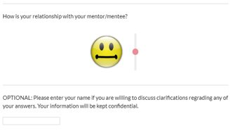
tgnc
undergraduate stem student retention
Mentor program
Align with current NU academic Plan, Experience Unleashed​
Year-End Assessment Survey
Mid-Year Assessment Survey
background
Support student mentees
Support faculty, staff, and graduate student mentors by conducting mentor training​
theory
Applications for mentors and mentees will be completed through a NU Qualtrics survey​
proposal
considerations
looking forward
Notes:
Applications and assessments will be done using NU Qualtrics surveys. These surveys will allow NU to evaluate the effectiveness of the mentor program and determine the future state of the program. ​
​
Mentors and mentees will receive respective surveys to assess the impact of the mentor program. The first survey will be sent mid-year. The intent of this survey is to understand the impact and satisfaction of the first half of the year, identify trends, and make changes for the second half of the year. At the end of the year, a different survey will be sent to all participants. The data collected from these surveys will be used to assess and adjust the mentor program based on feedback collected in the survey responses.
​

Slide 11
tgnc
undergraduate stem student retention
Budget + funding
Estimate of population must be established
Program expenses need to be considered
background
Funding opportunities
theory
proposal
considerations
looking forward
Notes:
In estimating the budget for this proposal, we first needed to get an estimate on the population size. Data related to TGNC populations at Northeastern is difficult to come by, as it is not reported as a part of the Integrated Postsecondary Education Data System (IPEDS) nor on Northeastern’s websites. To accomplish this estimation, several data points were utilized across multiple studies and sources. ​
​
Then we considered what resources require funding to establish and maintain both programs.
We also considered funding opportunities internal and external to the university.

Slide 12
Population modeling
T
GNC
TGNC
Meerwijk & Sevelius​ (2017)​
| 0.39%
Williams Institute (2016)​
1,397,150 | 0.58%
Williams Institute (2022)​
995,200 | 0.37%
341,800 | 0.13%
133,700 | 0.50%
Census Bureau (2021)​
| 0.60%
| 1.70%
Northeastern (2021)​
31 | 0.14%
Proposal Model
112 | 0.50%
90 | 0.40%
202 | 0.91%
Notes:
This slide represents a collection of different estimates of transgender and gender nonconforming (TGNC) populations in the United States.
Meerwijk & Sevelius (2017) and the Williams Institute (2016; 2017) analyzed multiple population models using different methodology to estimate the transgender population.
Census data (Anderson et al.) comes from a 2021 Household Pulse Survey (HPS) pooled over the period of July 21 to September 13; the HPS asks questions about sex at birth, current gender identity, and sexual orientation - and information listed here represents the bureau’s analysis of answers to those three questions. ​
​
Data from Northeastern reflects only respondents who declined to provide a gender on a binary scale. It is likely that this number is incorrect. Furthermore, the data did not differentiate between transgender and cisgender for questions related to gender.
Using the information gathered from these external sources and government data, in combination with the knowledge that a greater portion of college students are identifying as TGNC, this is our initial estimate as to the TGNC population at Northeastern. This does not account for differences in region and culture, nor does it consider that not every TGNC person is out and willing to indicate their gender in such surveys.

Slide 13
Population modeling
T
GNC
TGNC
Adjusted Northeastern Totals | 22,314
116 | 0.52%
93 | 0.42%
209 | 0.94%
Bouvé College of Health Sciences | 2,134​
11 | 0.52%
9 | 0.42%
20 | 0.94%
College of Engineering | 3,958
20 | 0.51%
16 | 0.40%
36 | 0.91%
Khoury College of Computer Science | 2,938
15 | 0.51%
12 | 0.41%
27 | 0.92%
College of Science | 3,374
17 | 0.50%
14 | 0.41%
31 | 0.92%
STEM Students | 12,404
63 | 0.51%
51 | 0.41%
114 | 0.92%
Notes:
​We then used this model and applied it to the Northeastern Undergraduate student population, as reported in Facts and Figures annually (Northeastern University, 2021a). These numbers were calculated by multiplying the overall population of each college by the percentages from our model orounding up (since were working with people, not hypotheticals). As a result, the total number is lightly higher than the previous slide; the new overall university total is reflected in the adjusted model line. While we have data on the population across the whole institution, for the purposes of this presentation we are displaying only colleges that focus on STEM fields: the Bouvé College of Health Sciences, the College of Engineering, the Khoury College of Computer Sciences, and the College of Science. ​
This model also does not consider if some fields of study have a higher or lower than average population of TGNC students; it applies the same percentage calculation across all colleges. According to the LGBTQA resource center, oSTEM (or Out in STEM) weekly affinity group meetings have 5-10 students, and 10-15 for larger events (K. Vetiac, personal communication, February 23, 2023). Obviously, this number is significantly smaller than our suggested model. Therefore, in this initial proposal a pilot program of five mentors with five mentees each (25 total) is suggested, with room for future growth.

Slide 14
Operating costs
Month
Year
Mentor Salaries
$210 (x1) | $1,050 (x5)
$1,680 (x1) | $8,400 (x5)
Food for Staff Meetings
$90
$720
QR.io QR Generator
$350 (12mo)
General Supplies
$500
Discretionary (10%)
$997
Total Annual Operating Cost
$10,967
Notes:
For the purposes of calculating operating costs, a year consists of eight (8) months, four (4) in each Fall and Spring semester.
To establish a budget and project operating costs, we first calculated how many hours mentors would work. Mentors should be meeting with each mentee for up to two hours in one month. Additionally, mentors are expected to participate in a monthly staff meeting for another two hours. To ensure mentees feel a sense of belonging, mentors should invite their mentees to one event on campus every month we allotted that another two hours. This totals 14 hours a month. If mentors are paid minimum wage, $15/hour, this proposal would mean paying each mentor $210 a month, or $1680 a year. With five mentors, this totals $8400 per year.
Additional funds are required to maintain the QR code; this particular software allows analytics like number of scans or tracking peak times. Food should be provided for meetings, and a general supply budget is also allocated for. A 10% discretionary fund can be used to make up for any potential differences in hours, supplies, food, or other unexpected costs.
The total cost of this program as proposed is $10,967 dollars a year. This is around $439 per mentee in the program, or $96 dollars per TGNC STEM student based on our model.

Slide 15
tgnc
undergraduate stem student retention
Budget + funding
Internal funding from colleges/programs
Internal grant funding opportunities
background
External funding from community partners
theory
proposal
considerations
looking forward
Notes:
In order to fund this program, an internal funding source can be gathered from support of the STEM college offices. If split evenly across the four colleges with STEM fields, it would cost each college $2742. Alternatively, colleges and/or individual departments could contribute funds based on the number of mentees housed in each program. Current program costs estimate $439; departments can currently assist students for travek grants for external conferences around $500, so this isn’t out of the realm of possibility.
Further additional funding could come in the form of research or program grants offered by Northeastern. One example comes in the form of the CSSH Multigenerational Research Grant: the goal of this grant is to engage and support the “development of multi-generational research teams that engage faculty, graduate and undergraduate students to advance faculty research” (CSSH, 2020). However, this would necessitate that faculty take this on as a research project. ​
​
External funding is also a potential method to assist in the funding of this program. As an example, MassBay Community College operates a STEM mentor program that connects students with professionals in the field. It has corporate sponsorships from a variety of partners, including Sanofi, ABI-LAB, MathWorks, and STEM Starter Academy (MassBay Community College, 2023). There are other organizations local to Boston, or related to oSTEM that could offer additional avenues of financial assistants.​

Slide 16
tgnc
undergraduate stem student retention
Legal issues
A Responsible Employee at Northeastern University is any University employee, including faculty, staff and student employees within Residence Life.
background
Responsible Employees are required to report allegations of sex and gender-based discrimination, including sexual misconduct, to the Title IX Coordinator.
theory
proposal
OPEN – Office of Prevention and Education at Northeastern​
considerations
looking forward
Notes:
The LGBTQA Resource Center is housed in residential, cultural and spiritual life (Northeastern University, 2021b). Student employees in residence life are "responsible employees," therefore the mentors in this program are required to report allegations of sex and gender-based discrimination, including sexual misconduct, to the Title IX Coordinator (Northeastern University, 2023). Since TGNC undergraduate STEM students experience extensive discrimination, harassment, and mental health challenges (Alonso, 2023; Maloy et al., 2022) and 69% of queer faculty in STEM fields report that their departments are uncomfortable places to work (Freeman, 2018), it is likely that mentees in the program will describe or share experiences that require reporting. ​
​
To assist in this process, OPEN–the Office of Prevention and Education at Northeastern–offers interactive and informative customized presentations for classes, student organizations, athletic teams, fraternities and sororities, first-year seminars, classes, staff and faculty (OPEN, 2023b). Online modules exist as an accompanying resource and cover a variety of topics including alcohol and drug abuse, sexual violence prevention, bystander trainings, preventing sexual violence as a student leader, trauma-informed response to disclosures of sexual violence, sexual health, as well as other student concerns–like resiliency and creating new and lasting friendships on campus (OPEN, 2023a).​
​

Slide 17
tgnc
undergraduate stem student retention
Concluding thoughts
Annual Retreat
Transgender Archives at Northeastern
background
Name and Pronoun Preference Process
University-Wide Self-Reporting Census
theory
proposal
considerations
looking forward
Notes:
These resources were created for the NU LGBTQA Resource Center to use and adjust as they see fit. This project was completed without direct input from students and instead, from information gathered through the Resource Center and our own research. The LGBTQA community is an ever changing environment and these resources are meant to grow, change, and adapt for this community.

Slide 18
References
Adams, F. (2015, October 18). Transgender students deserve equal access. The Chronicle of Higher Education. Retrieved February 26, 2023, from https://www.chronicle.com/article/transgender-students-deserve-equal-access/
Alonso, J. (n.d.). Mental health is the top student stressor. Inside Higher Ed. Retrieved January 22, 2023, from https://www.insidehighered.com/quicktakes/2023/01/09/mental-health-top-student-stressor
Anderson, L., File, T., Marshall, J., McElrath, K., & Scherer, Z. (2021, November 4). Census Bureau survey explores sexual orientation and gender identity. United States Census Bueareau. Retrieved from https://www.census.gov/library/stories/2021/11/census-bureau-survey-explores-sexual-orientation-and-gender-identity.html
Bardio, J., & Brown, N. (n.d.). Boston's LGBTQA+ history. Bostons LGBTQA+ History. Retrieved February 24, 2023, from https://lgbtqahistory.library.northeastern.edu/queer-intime-exhibit/
Carnegie R1 and R2 research classifications doctoral ... - CEHD. (n.d.). Retrieved February 10, 2023, from https://cehd.gmu.edu/assets/docs/faculty/tenurepromotion/institutions-research-categories.pdf
Cech, E. A., & Rothwell, W. R. (2018, December 7). LGBTQ inequality in Engineering Education - Wiley Online Library. LGBTQ Inequality in Engineering Education. Retrieved February 24, 2023, from https://onlinelibrary.wiley.com/doi/10.1002/jee.20239
Fernández, Ó., Lundell, D., & Kerrigan, S. (2018). Taking High-Impact Practices to Scale in Capstone and Peer Mentor Programs, and Revising University Studies’ Diversity Learning Goal. The Journal of General Education (University Park, Pa.), 67(3-4), 269–289. https://doi.org/10.5325/jgeneeduc.67.3-4.0269
Flores, A.R., Herman, J.L., Gates, G.J., & Brown, T.N.T. (2016). How Many Adults Identify as Transgender in the United States? The Williams Institute, UCLA School of Law
Freeman, J. (2018). LGBTQ scientists are still left out. Nature, 559(7712), 27–28. https://doi.org/10.1038/d41586-018-05587-y
Graves, D., & Dubrow, G. (2019). Taking Intersectionality Seriously: Learning from LGBTQ Heritage Initiatives for Historic Preservation. The Public Historian, 41(2), 290–316. https://doi.org/10.1525/tph.2019.41.2.290
Herman, J.L., Flores, A.R., O’Neill, K.K. (2022). How Many Adults and Youth Identify as Transgender in the United States? The Williams Institute, UCLA School of Law
Hoover, E. (2022, July 12). Finding safety: The path 2 LGBTQ students took to college. The Chronicle of Higher Education. Retrieved from https://www.chronicle.com/article/finding-safety-the-path-2-lgbtq-students-took-to-college
The Integrated Postsecondary Education Data System. Intergrated Postsecondary Education Data System. (2021). Retrieved February 26, 2023, from https://nces.ed.gov/ipeds/datacenter/InstitutionProfile.aspx
Legg, K., Cofino, A., & Sanlo, R. (2020). Lesbian, Gay, Bisexual, and Transgender College Students: Revisiting Retention. Journal of College Student Retention: Research, Theory & Practice, 21(4), 417–430. https://doi.org/10.1177/1521025119895513
Maloy, J., Kwapisz, M. B., & Hughes, B. E. (2022). Factors Influencing Retention of Transgender and Gender Nonconforming Students in Undergraduate STEM Majors. CBE Life Sciences Education, 21(1), ar13–ar13. https://doi.org/10.1187/cbe.21-05-0136
MassBay Community College. (2023). STEM mentor program. MassBay Community College. Retrieved from https://www.massbay.edu/stem/mentor
Meerwijk, E. L., & Sevelius, J. M. (2017). Transgender population size in the United States: A meta-regression of population-based probability samples. American Journal of Public Health, 107(2). https://doi.org/10.2105/ajph.2016.303578
Mintz, S. (2023, January 2). The power of relationships in undergraduate education. InsideHigherEd. Retrieved from https://www.insidehighered.com/blogs/higher-ed-gamma/power-relationships-undergraduate-education
Northeastern University. (2022, March 3). Home. Academic Plan. Retrieved from https://academicplan.northeastern.edu/#academic-plan-2
Northeastern University. (2021). Facts and figures 2021. Facts and Figures. Retrieved from https://facts.northeastern.edu/
Northeastern University. (2021). Mission and history. LGBTQA. Retrieved from https://lgbtqa.northeastern.edu/mission-and-history/
Northeastern University. (2023). Tips for Responsible Employees. Title IX. Retrieved from https://www.northeastern.edu/ouec/training-and-education/
OPEN. (2023). Online modules. OPEN. Retrieved from https://open.studentlife.northeastern.edu/programs-and-services/online-modules/
OPEN. (2023). Presentations and programs. OPEN. Retrieved from https://open.studentlife.northeastern.edu/programs-and-services/presentations/
Paris, B. (2023, February 13). Inside higher ed. Society gives students an A for effort (opinion). Retrieved February 26, 2023, from https://www.insidehighered.com/admissions/views/2023/02/13/society-gives-students-effort-opinion
QR.io. (2023). Pricing plans made simple. QR.io. Retrieved from https://qr.io/pricing
Rendón , L. I., & Muñoz, S. M. (2011). Revisiting validation theory: Theoretical foundations, applications, and extensions. Enrollment Management Journal, 5(2), 12–33. https://doi.org/https://www.laurarendon.net/wp-content/uploads/2021/07/emj-issue.pdf
Rendón, L. I. (1994). Validating culturally diverse students: Toward a new model of learning and student development. Innovative Higher Education, 19(1), 33–51. https://doi.org/10.1007/bf01191156
Schlossberg, N. K. (1989). Marginality and mattering: Key issues in building community. New Directions for Student Services, 1989(48), 5–15. https://doi.org/10.1002/ss.37119894803
Tinto, V. (1993). Leaving college: Rethinking the causes and cures of student attrition (2nd ed.). University of Chicago Press.

